Slide 1

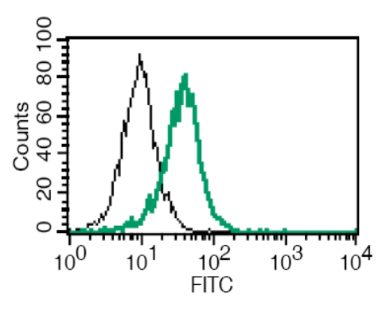
ReliaTech GmbH
Rat anti-mouse VEGFR-2/Flk-1
(Cat #103-M32)
Fig. 1: FACS analysis with primary mouse lung microvascular endothelial cells (MLMEC).
http://www.reliatech.de / orders@reliatech.de

